Slide 1
Final Presentation Chatter
Sangeetha Chandrashekar, Jerry Lanning, Virat Goradia
Sibendu Dey, Tarun Kumar Attayampatty Sekar

Slide 2
System Functionality
Core Features provided in the application:
User to user conversation
A user will be able to search for a user and message to the user directly
Group messaging
A user will be able to search for a group and will be able to message in that group if he/she is part of the group.
A user will be able to perform other activities on the group such as viewing the group details, creating sub-group(moderator), setting password to a group(moderator).
Every user also has an option to a create a group and add/remove users from it.

Slide 3
System Functionality(contd)
Invite System
Every user will be able to add users to a group if the user is the moderator of the group.
If a user wants to join a group, then the user must send a request invite to the moderator of the group who will accept or reject the invite.
Profile
Each user has a seperate profile which can be updated by the user at any time.
The user can update their email address, image url, password.
The user also has an option to update his/her profile access to be set either public or private

Slide 4
System Functionality(contd)
Circles
A user will be able to search for a user and will be able to follow or unfollow a user.
Once a user follows another user he/ she will be able to view the details of the user following.
If a user has set their profile is private, then the list of users following the user will not be able to access his/her details.

Slide 5
Programming Features Provided
Hosted the app in the cloud.
Created a client side part to the application as a jar which the user can run and access the various features of the app.
Created custom exception for each kind of error thrown from the network layer of the app.
Implemented the singleton pattern in all the JPA service classes and made use of the singleton in the Junit test cases.
Made use of various design patterns – factory method, abstract pattern, etc which improved the code readability.

Slide 6
Security Features Provided
The user email address and password are encrypted and saved in the database. Thus even if the DB is compromised, the data can not be decrypted unless the decryption key is known to the hacker. Java crypto cipher is used by our system for encryption.
In order to provide security to a chat group, only the moderator of the group can accept or reject invitations.
A user will be able to delete a message from his chat conversation and that message will be removed from that particular window view, but the deleted message will still be persisted in the database.
A user will not be able to inject SQL query in any form in the entire application.

Slide 7
Is it useful for the client?
Client is unable to enter invalid/incorrect inputs.
Client is provided an appropriate error message whenever they enter any invalid/incorrect data or when they try to perform a functionality they do not have access to.
The error message is in simple english making it easy for the client to understand on the high level as to what went wrong. They need not worry about the internal working of the system.
Clients can easily navigate the system using numbers that map to a particular action they wish to perform. Example: The console displays: “1 - Chat with User.” Client just needs to enter “1” to be able to chat with some user.

Slide 8
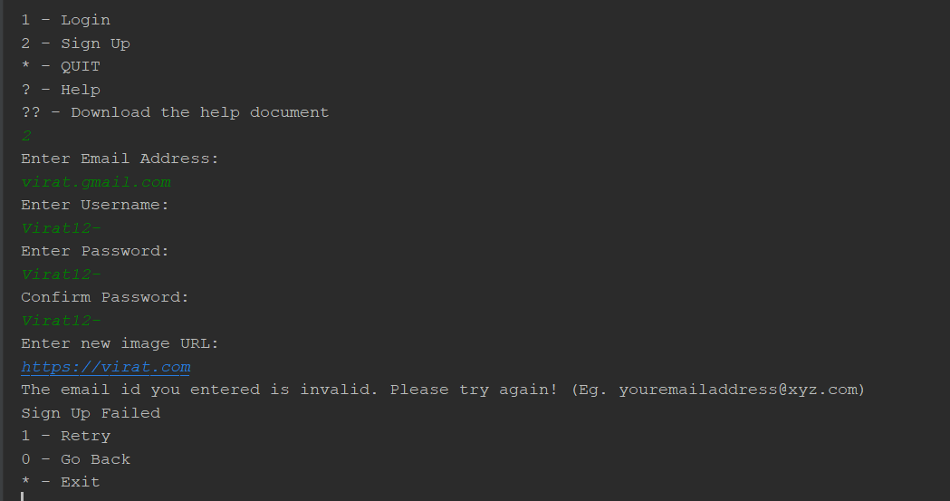
Invalid Email

Slide 9
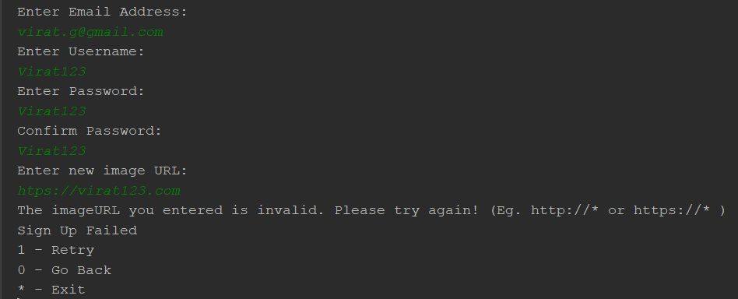
Invalid image url

Slide 10
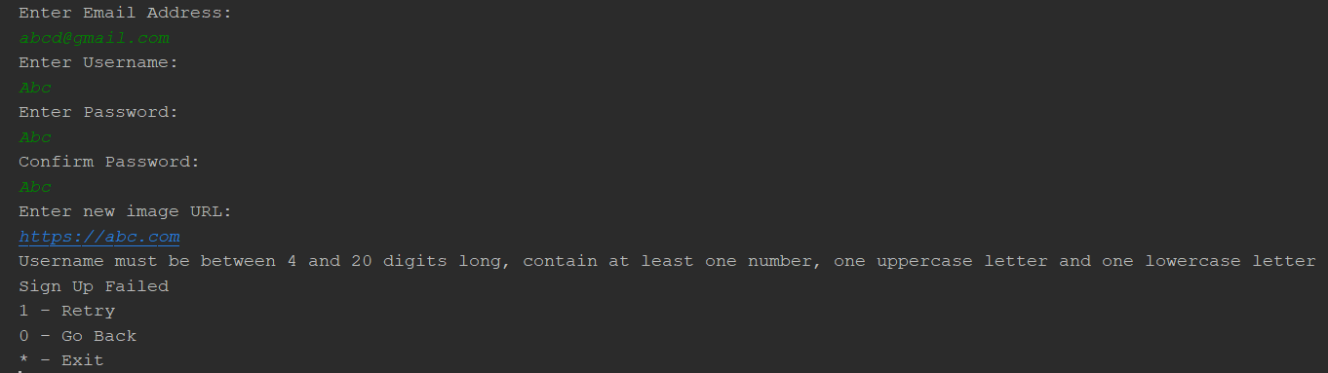
Invalid Username

Slide 11
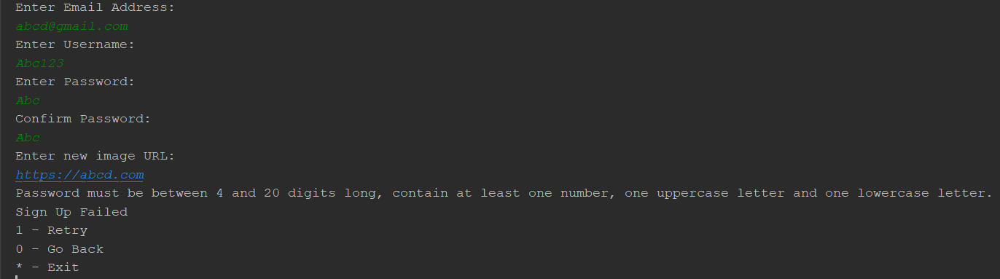
Invalid password

Slide 12
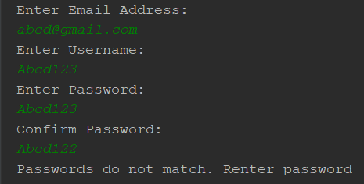
Incorrect Password

Slide 13
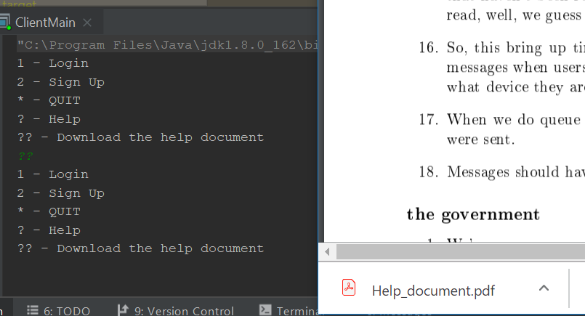
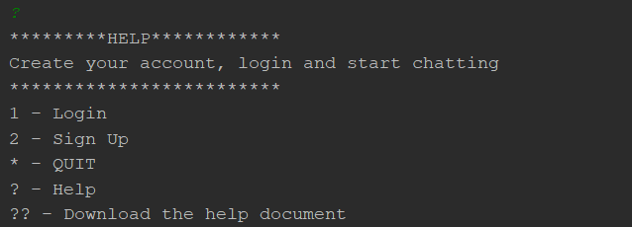
Is it useful for the client?
Client is provided with a help window which helps them understand how to interact with the system and what different functionalities are available to them.

Slide 14
Is it useful for the client?
Client is able to time shift, that is, when they come back online, it looks like the service is picking up from where they left off.
Client can interact with the system with just the basic understanding of simple English language.
Client can make their profiles either public or private. This enables the client to either be found or not. Therefore, they get control in their hands, if they want to keep themselves visible to others or not, giving them a good feel of security.
Client gets a separate window for their respective personal or group conversations.

Slide 15
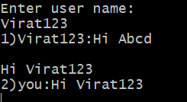
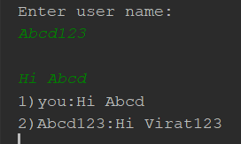
Message windows

Slide 16
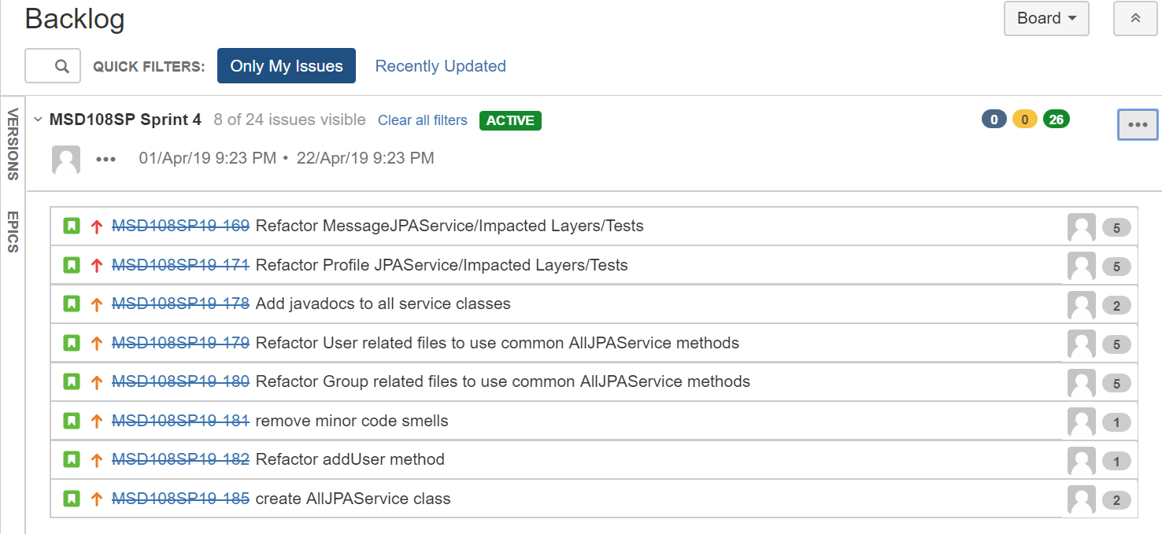
Is there evidence from the backlog/requirements to support these claims?

Slide 17
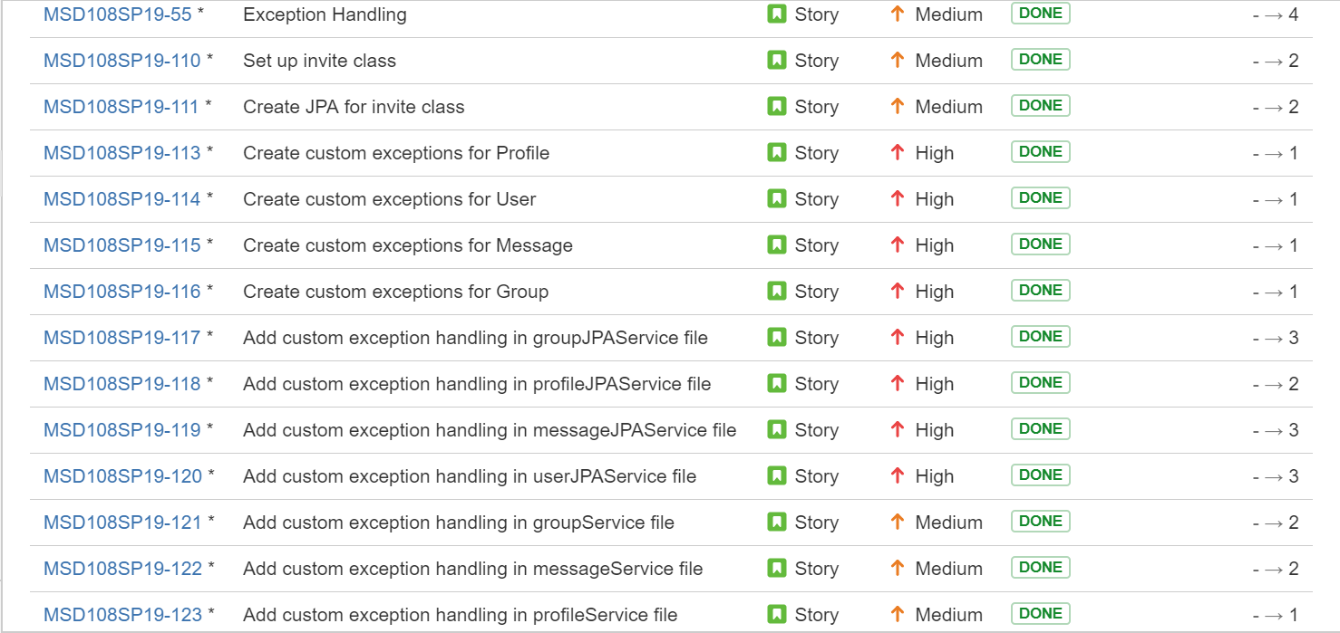
Is there evidence from the backlog/requirements to support these claims?

Slide 18
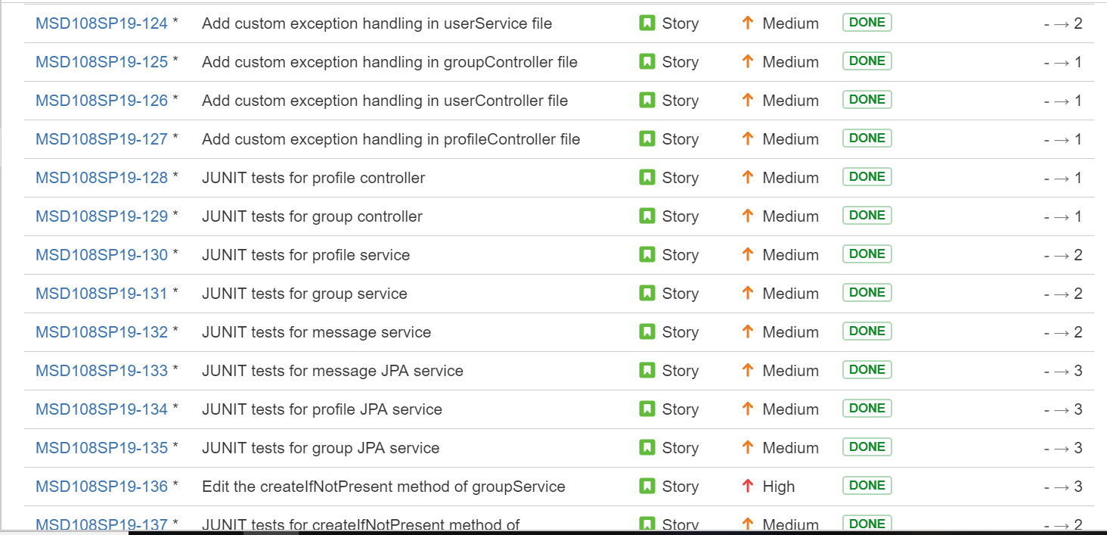
Is there evidence from the backlog/requirements to support these claims?

Slide 19
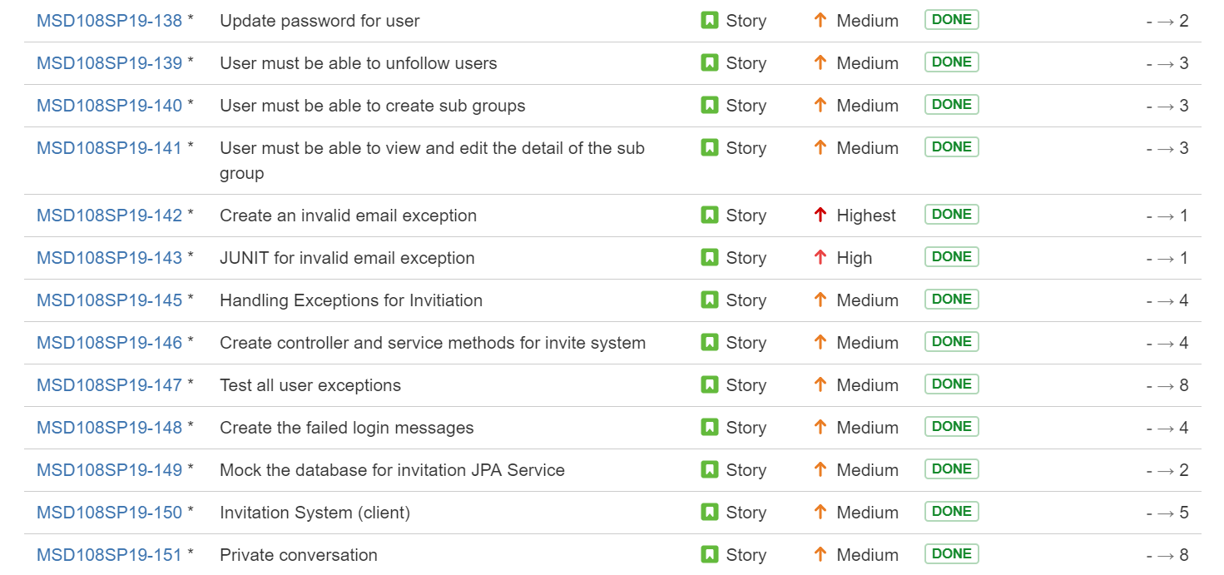
Is there evidence from the backlog/requirements to support these claims?

Slide 20
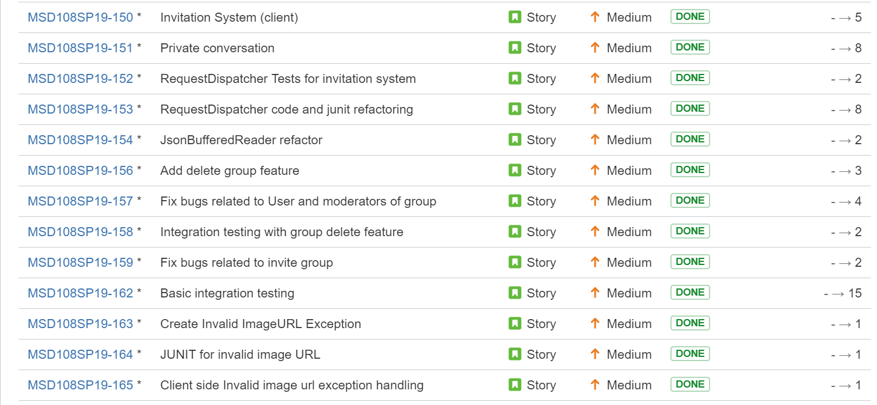
Is there evidence from the backlog/requirements to support these claims?

Slide 21
Job Quality
Designed the entire code base using MVC architecture to have clear bifurcation between the implementation layers.
Added JavaDocs for all classes and methods to have a better understanding of the code functionality.
Added SonarLint to development environment to avoid code smells while coding.
Every new feature was tested using Junit test cases and integration tests.
Every new feature had a separate branch on GitHub. To merge to other branches, we used git pull requests and facilitate peer acknowledgments.

Slide 22
Job Quality
A pseudo-master branch was implemented every sprint and all the code merges to this branch were done using PR. This helped us to maintain constant peer review for every code merge and nip the problem in the bud, if any.
These pseudo-master branches also had CI tool Jenkins enabled to it to track the code quality.
Feedback from the sprint review report helped us further improve the code quality.

Slide 23
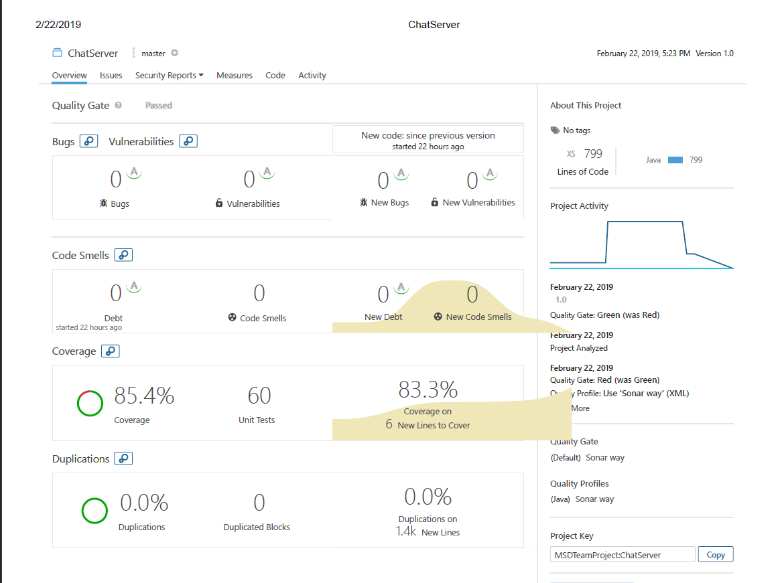
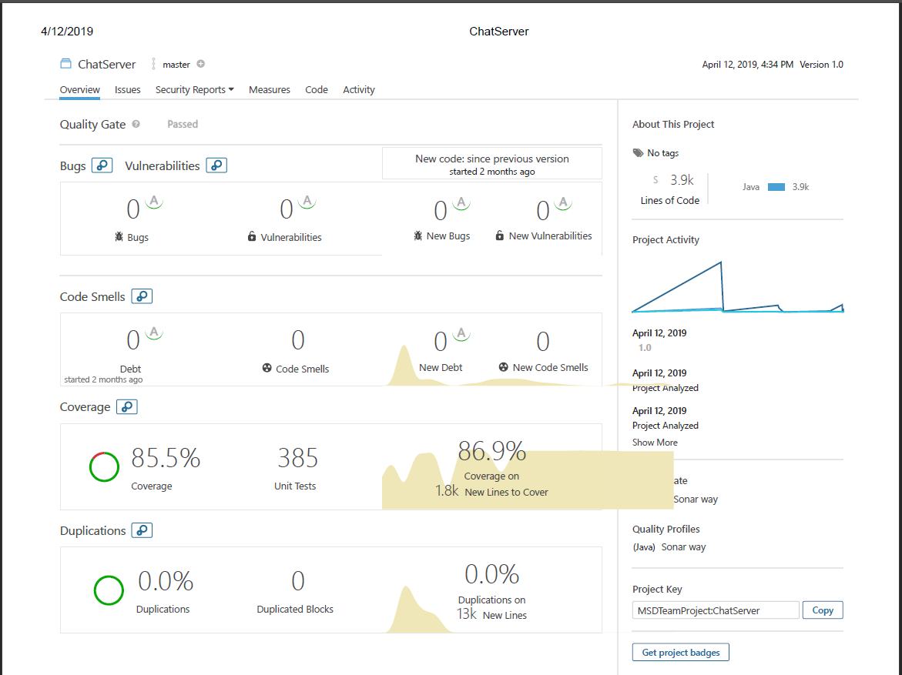
Job Quality
Constantly monitored Jenkins and SonarQube report to assure 85% or above code coverage, fixing bugs and eliminating code smells.
Fig 1. Sprint 1 SonarQube report (60 tests)
Fig 2. Sprint 4 SonarQube report (385 tests)

Slide 24
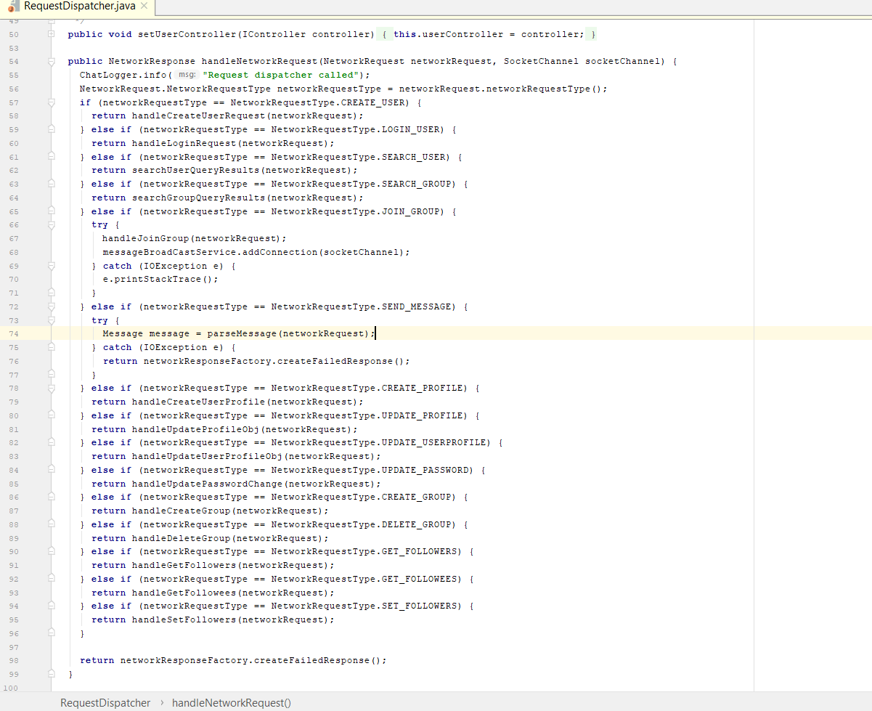
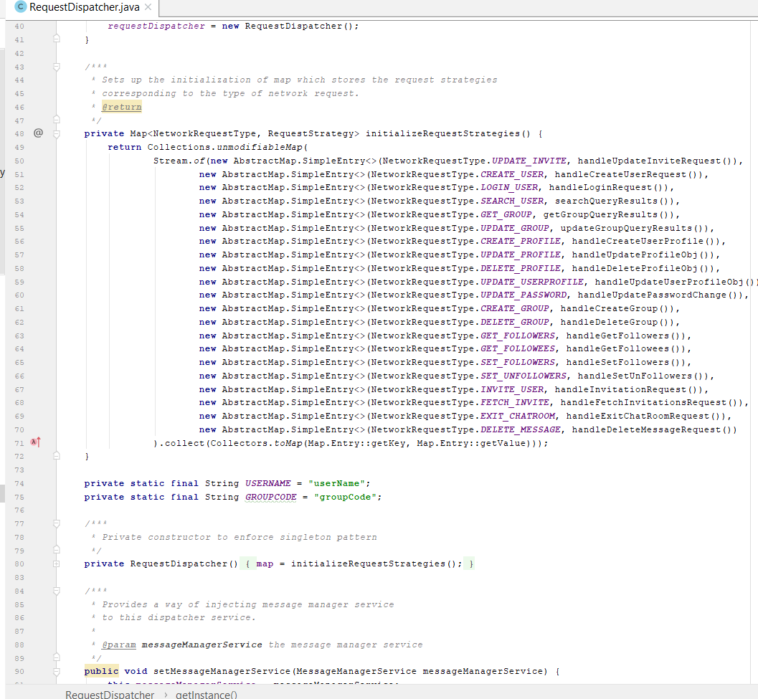
Job Quality
Had a dedicated sprint to refactor the code to have better readability, wherever it was deemed necessary.
Refactored the code to include design patterns such as singleton and strategy pattern etc.
Sprint 2 RequestDispatcher.java
Code snippet
Sprint 4 RequestDispatcher.java code snippet with strategy pattern

Slide 25
Process and Teamwork
Our process involved splitting the team into a couple teams.
One working on the client side.
The other team working on the controller and service layers.
Development Branch on GitHub
Everyone creates PRs to a single branch and everyone contributes to the same code base to avoid merge conflicts.
Separation of Tasks
Each team had their own tasks in the process and were able to focus on ensuring their tasks were working.
Focus on the Goals with more dependencies.
We don’t want other people affected because we haven’t completed a specific task.
Managing Our Course Load
Ensuring people with heavier weeks were given lighter loads when they needed it.

Slide 26
Working as a team
Each member was open about their workload.
People with heavier workloads wouldn’t have to as many tasks as someone with a lighter workload that week. This came with the expectation they would do more work in the week they had a lighter workload.
Each member was honest about what tasks they were comfortable with.
Assigning tasks to people with the most experience in each task.
Daily Scrums
Working in daily 10-15 min scrums helped us communicate progress
Code Meetings
Sitting down and coding together allowed for easy communication.

Slide 27
The Process, Did it Work?
The process as a whole worked.
Completing tasks with more dependencies.
Completing tasks with more dependencies early led to less frustration between team members.
Ensure tested code is pushed to master.
This lead to code that didn’t break when other people used it.
Daily Scrums
Communication is KEY, the daily scrums kept us on track.

Slide 28
Automation
Work in a build, test and promote process.
We started by building a feature.
After building a feature we put it through the testing phase.
If the build failed tests we needed to alter the way we built the code and refactor the existing code.
After passing our tests we could push our code to a develop branch for others to try to find bugs
If no bugs were found we thought about different ways to refactor the code to be more efficient.
After everyone tried to break our code and gave their input we could push the develop branch to master.

Slide 29
Recognize Short Comings
Separation of Tasks
We couldn’t all just work on the list of Goals, we had to separate the list of goals into individual tasks.
Separation of layers
Allowed us to more efficiently develop code.
Too many Goals/Commitments!
After a couple sleepless nights we learned how to better predict our work load.
Merge Conflicts!
Many merged conflicts arose, by creating a develop branch everyone branched off of it allowed us to create PR’s and recognize merge conflicts before they happened!
Ask for Help!
If you’re feeling overwhelmed the best thing to do is ask for help!

Slide 30
Technology Transfer
Extensible codebase.
Good design principles makes way for a good future development.
Live system up and running.
Live system has an embedded database for testing the product functionalities.
System demo video.
Shows overview of the core functionality.
System setup video.
Tutorial to demonstrate the steps for running the system.

Slide 31
Future Enhancements to the Application
Reply to particular message in separate thread.
Forwarding message to other groups.
Tracking the source of the message that has been forwarded.
Sending and receiving attachments.
Sending auto-delete messages to a user/group.
Providing localisation in the app that supports various languages.

Slide 32
Any Questions???
Please contact us at the following email addresses:
Jerry Lanning <lanning.j@husky.neu.edu>
Sangeetha Chandrashekar <chandrashekar.s@husky.neu.edu>,
Sibendu Dey <dey.s@husky.neu.edu>,
Virat Goradia <goradia.v@husky.neu.edu>,
Tarun Kumar Attayampatty Sekar <attayampattysekar.t@husky.neu.edu>

